Slide 1
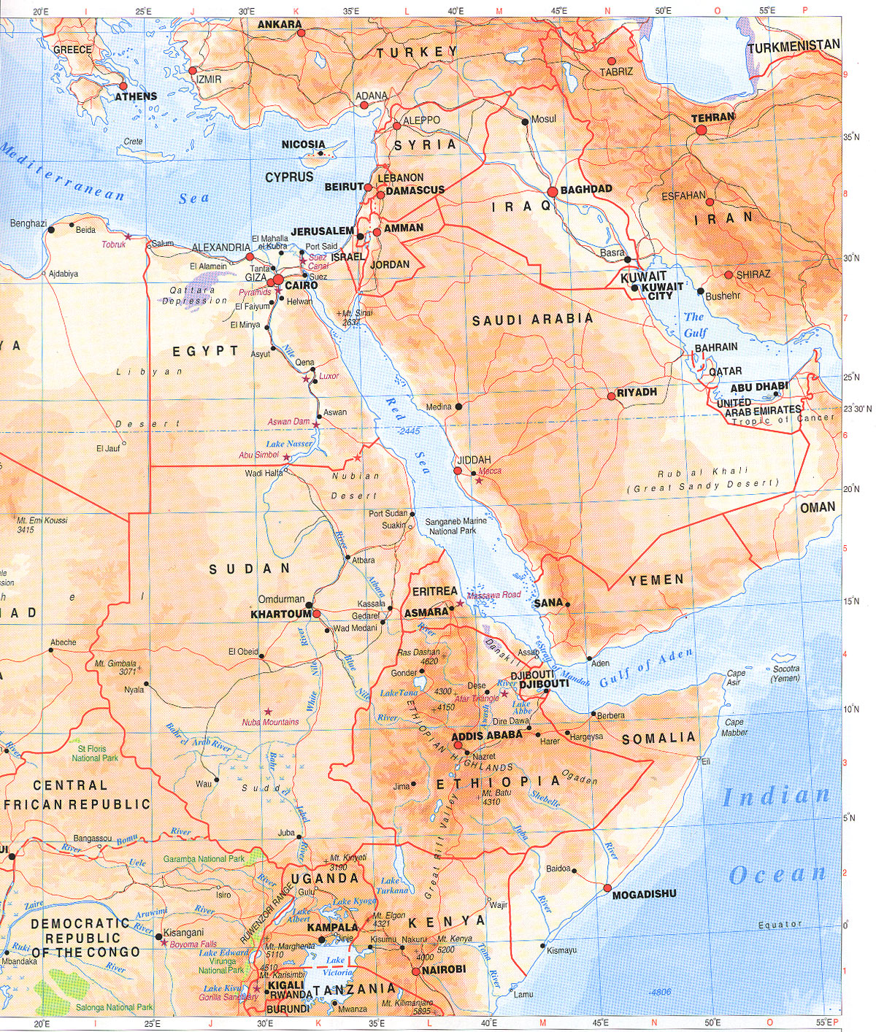
Asia Minor Standard 10.1
This is the area were most civilization began in prehistory and history.
With many water ways and food source the fertile crescent became the center of the universe to its people.
It is believed that this area was an abundant food source to the hunters and gathers.
With farming a big population of people emerged out of the land

Slide 2
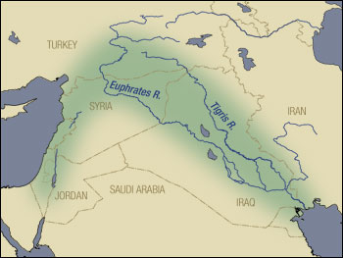
The people of the Asia Minor Standard 10.1
Mesopotamia
Egypt
Sumerian
Aramaeans
Phoenicians
Lydians

Slide 3
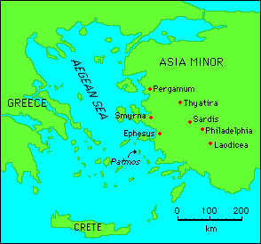
Who are the Greeks?
The Greeks sprang out of three civilizations,
The Minoans &
The Mycenaeans &
The Dorians.
Both civilizations are known as the Aegean civilization which lived around the Mediterranean sea.
World History Standard 10.1

Slide 4
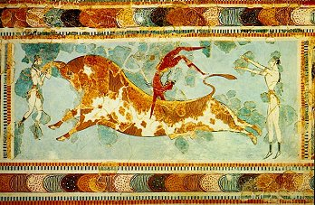
Who are the Minoans?
Minoans lived on the islands off Greece.
Minoans culture is often characterized as a society centered on goddess worship.
The Minoans were primarily a mercantile people engaged in overseas trade. Many historians and archaeologists believe that the Minoans were involved in the Bronze Age's important tin trade

Slide 5
Who were the Mycenaens
The Mycenaens lived on the main land.
Mycenaean civilization was dominated by a warrior aristocracy.
Not only did the Mycenaeans defeat the Minoans, but according to legend, they defeated Troy, a powerful city-state.
The Mycenaean period flourished between 1600BC and the collapse of their Bronze-Age civilization around 1100BC.

Slide 6
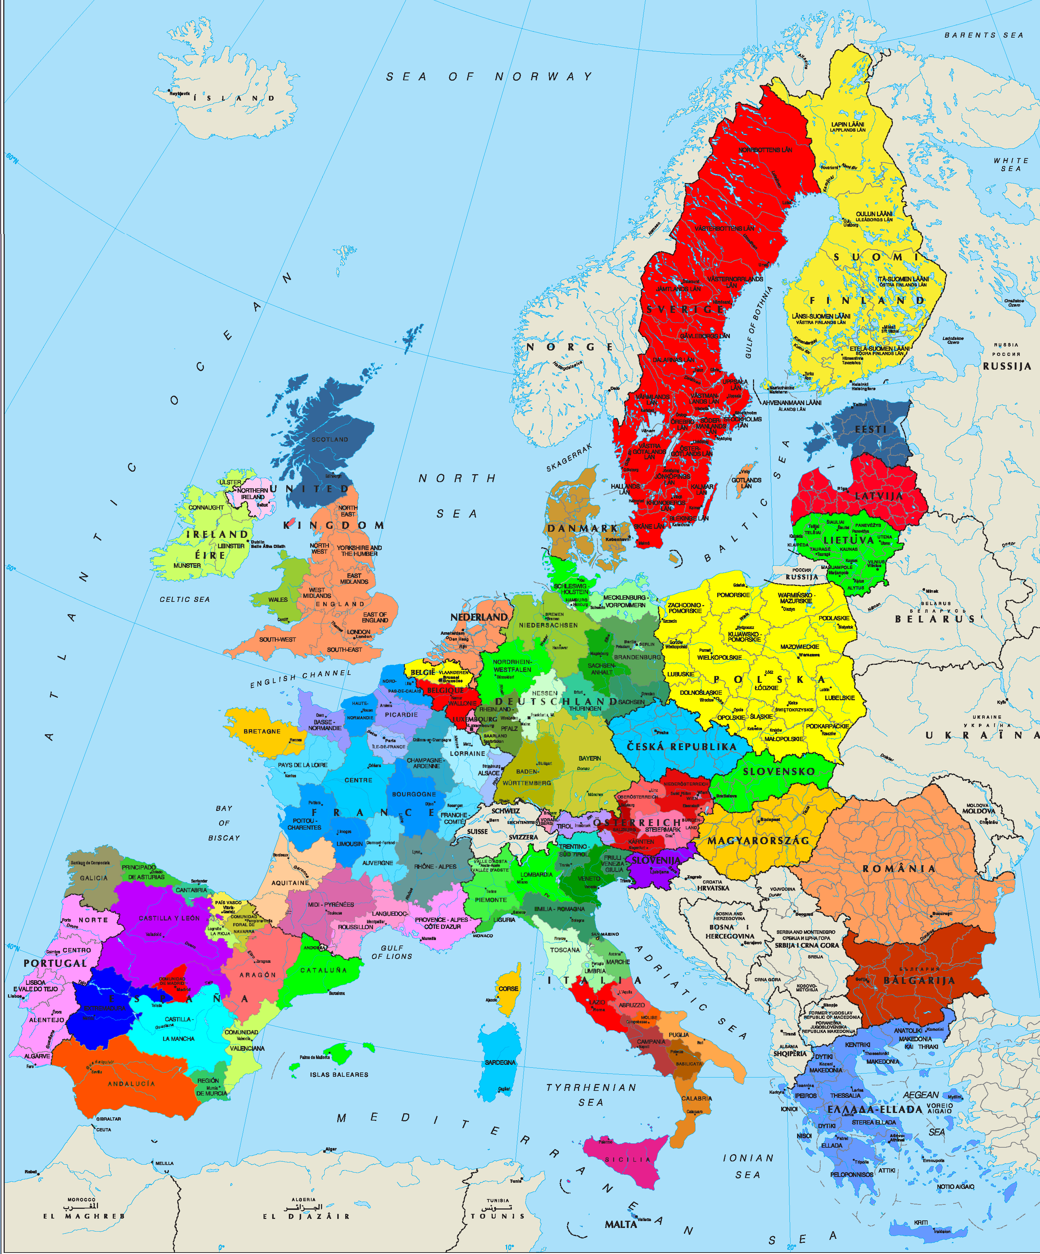
Maps
World History Standard 10.1

Slide 7
How the Greeks became a civilization.
The Mycenaeans overtook the Minoans and the two merged.
The Mycenaeans became powerful, but civil war weakened its strong fortresses and when invaders came they were easily overtaken.
The invaders were the Dorians who spoke the Greek language.
With the invaders the lost of many skills followed. Skills such as writing and boat making. This was know as the Dark Age for Greece.
World History Standard 10.1

Slide 8
Time Line
Minoans 2500 B.C. -1450 B.C.
Mycenaeans 2000 B.C.- 1150 B.C
Dorians 1150B.C – 700B.C. (Dark Age)
The Greeks (HELLENIC) emerged from the mix of these three civilizations to rule from 700B.C. to 336 B.C
What we know as the Greeks were influenced more by the culture of these three civilizations.
World History Standard 10.1

Slide 9
This powerpoint was kindly donated to www.worldofteaching.com
http://www.worldofteaching.com is home to over a thousand powerpoints submitted by teachers. This is a completely free site and requires no registration. Please visit and I hope it will help in your teaching.

